Slide 1

Data Description
Session 1
M. Kachour

Slide 2
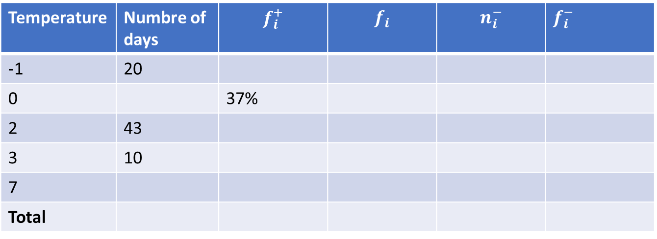
Exercise 1
We studied the morning temperature (i.e. measured between 7am and 7.30am) over 100 days chosen randomly from the periods of winter observed for the last 20 years.
Complete the following table:
Temperature | Numbre of days | $$f_{i}^{+}$$ | $$f_{i}$$ | $$n_{i}^{−}$$ | $f_{i}^{−}$
-1 | 20
0 |  | 37%
2 | 43
3 | 10
7
Total

Slide 3
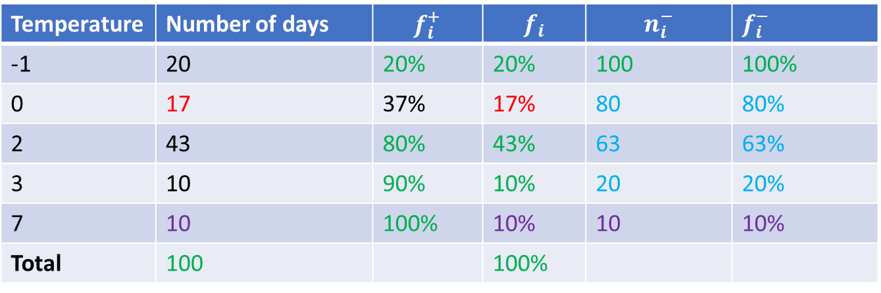
Exercise 1 - Solution
Temperature | Number of days | $$f_{i}^{+}$$ | $$f_{i}$$ | $$n_{i}^{−}$$ | $f_{i}^{−}$
-1 | 20 | 20% | 20% | 100 | 100%
0 | 17 | 37% | 17% | 80 | 80%
2 | 43 | 80% | 43% | 63 | 63%
3 | 10 | 90% | 10% | 20 | 20%
7 | 10 | 100% | 10% | 10 | 10%
Total | 100 |  | 100%

Slide 4
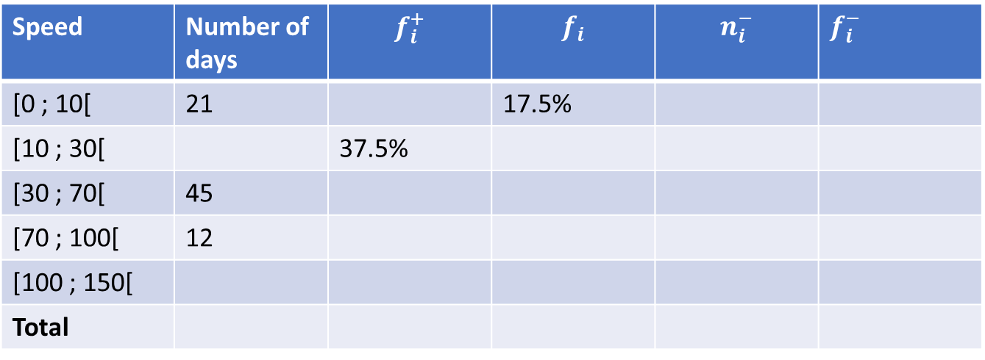
Exercise 2
We studied the morning speed (i.e. measured (in Km/h) between 7am and 7.30am) of the wind on n days chosen randomly from the periods of winter observed for the last 20 years.
Complete the following table:
Speed | Number of days | $$f_{i}^{+}$$ | $$f_{i}$$ | $$n_{i}^{−}$$ | $f_{i}^{−}$
[0 ; 10[ | 21 |  | 17.5%
[10 ; 30[ |  | 37.5%
[30 ; 70[ | 45
[70 ; 100[ | 12
[100 ; 150[
Total

Slide 5
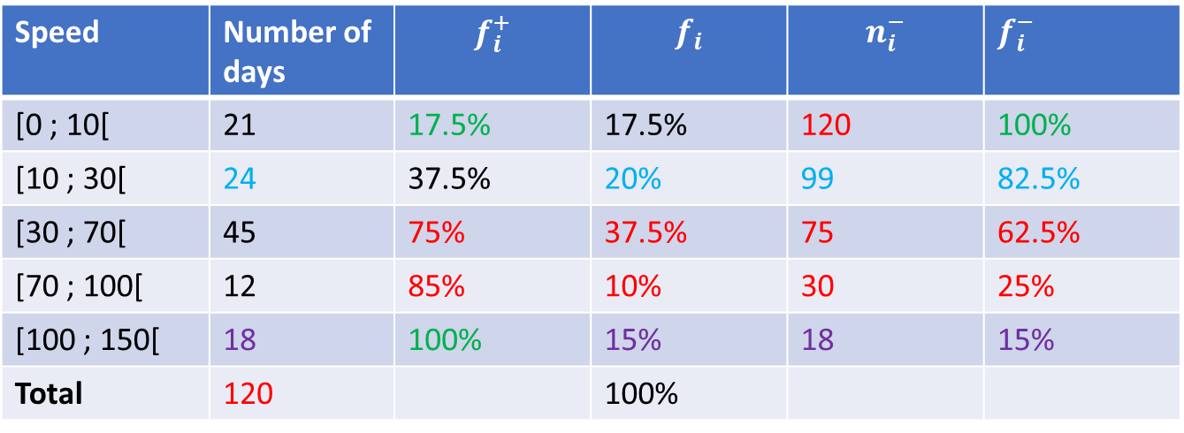
Exercise 2 - Solution
Speed | Number of days | $$f_{i}^{+}$$ | $$f_{i}$$ | $$n_{i}^{−}$$ | $f_{i}^{−}$
[0 ; 10[ | 21 | 17.5% | 17.5% | 120 | 100%
[10 ; 30[ | 24 | 37.5% | 20% | 99 | 82.5%
[30 ; 70[ | 45 | 75% | 37.5% | 75 | 62.5%
[70 ; 100[ | 12 | 85% | 10% | 30 | 25%
[100 ; 150[ | 18 | 100% | 15% | 18 | 15%
Total | 120 |  | 100%

